Slide 1
A project on customer retention
A case study on Indian E-commerce customers.
E-retail factor for customer retention.
Submitted by-
Rajesh Kumar Singh

Slide 2
INTRODUCTION
The success of online stores depend on many factors but the most important factor which can guarantee the success is Customer satisfaction. it has been posted as a fact that customer satisfaction is a key stimulant of purchase, repurchase and loyalty. To know the importance of customer satisfaction a comprehensive review of theories and model have been carried out. Through models for customer activation and retention it was learned that five major factors that contributed to the success of an e-commerce store have been identified as service quality, system quality, information quality, trust and net benefit. The research further more investigated the factors that influence the online customers repeat purchase intention. with the help of both utilitarian value and hedonistic value, factors affecting repeat purchase loyalty can be found out.
Background
The data on which below analysis has been carried out is taken from various Indian online shopping websites. Results indicate the e-retail success factors , which are very much critical for customer satisfaction.

Slide 3
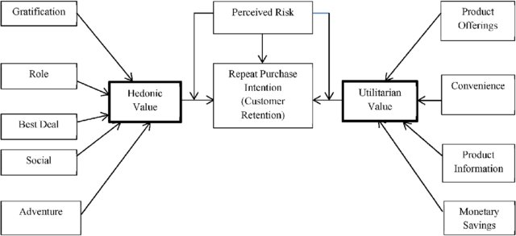
Representation of Customer Retention.
The retention of customer is based on three main factor.
Hedonic value.
Perceived value.
Utilitarian value.
The hedonic value consists of 5 characters that is gratification, role, best deal, social and adventure.
The Utilitarian value consists of 4 characters that is product offering, Convenience, Product Information, Monetary Savings.

Slide 4
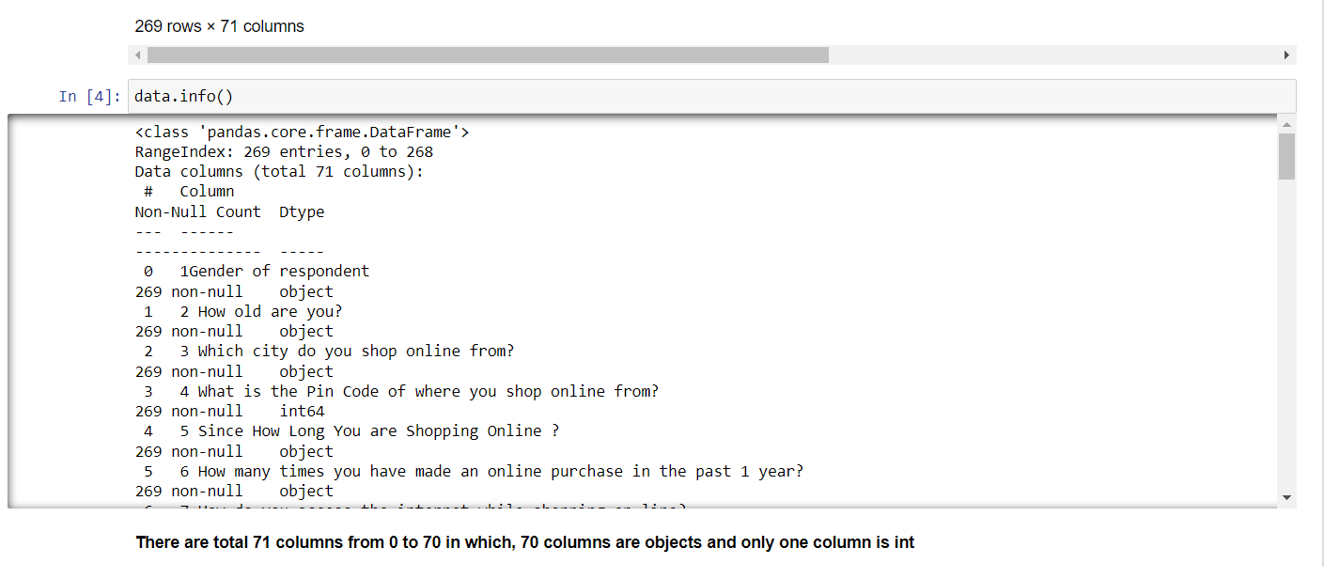
Analysis of datasheet.
This datasheet has 269 rows and 71 columns. Where column 4 is integer, which consists of pincode and rest all are objects. This datasheet doesn't have any missing values.

Slide 5
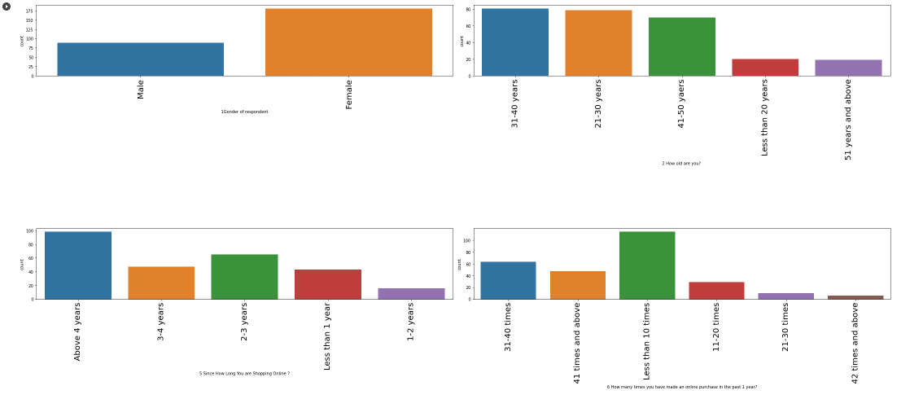
Exploratory Data Analysis.
I have done this EDA using countplot so that I can get knowledge about which value in every feature is most popular.

Slide 6
Key Observations.
From gender i can say that males are less and females are more which implies females do more online shopping.
From age group of 21-30 and 31-40 years people do more shopping and people who are 50 years old and above they do very less shopping.
People from the age of 4 years start online shopping.
Considering how many times online purchase was done in past one year then Less than 10 times has the highest count and 42+ times have least count means mostly people buy less then 10 times a year.

Slide 7
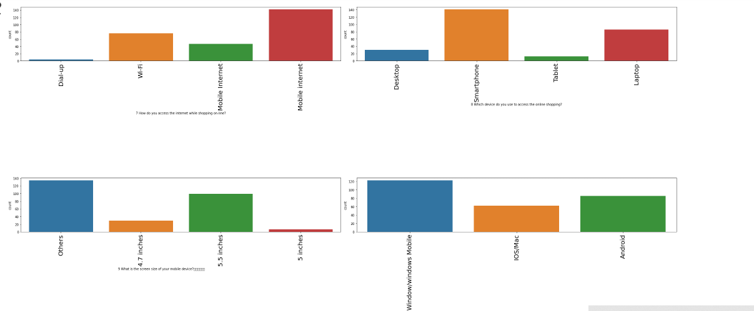
Considering how people accessed the internet while shopping online, we can see people used mobile internet more and very few used dialup for shopping.
Device from which access was made to do online shopping it indicates that smartphones were used more than laptops and very few used tablet.
Data indicates that screen size of 5.5 inch has the highest count while 5 inch and below were used less.
Operating system (OS) of device had window in it most then android and then ios for online shopping.

Slide 8
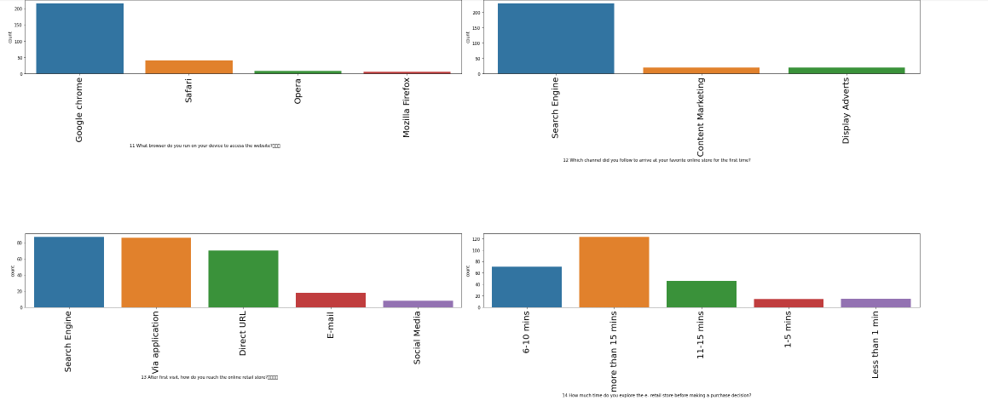
Google chrome browser was used to access the website mostly by people few used Firefox too.
Channel used to arrive at favorite online store for the first time was mostly through search engine then it was via mobile app and after came URL, few used e-mails and social media also.
How much time was taken to explore the e- retail store before making a purchase decision it can be noticed most people took 15 min and very few people took 1 mins only.

Slide 9
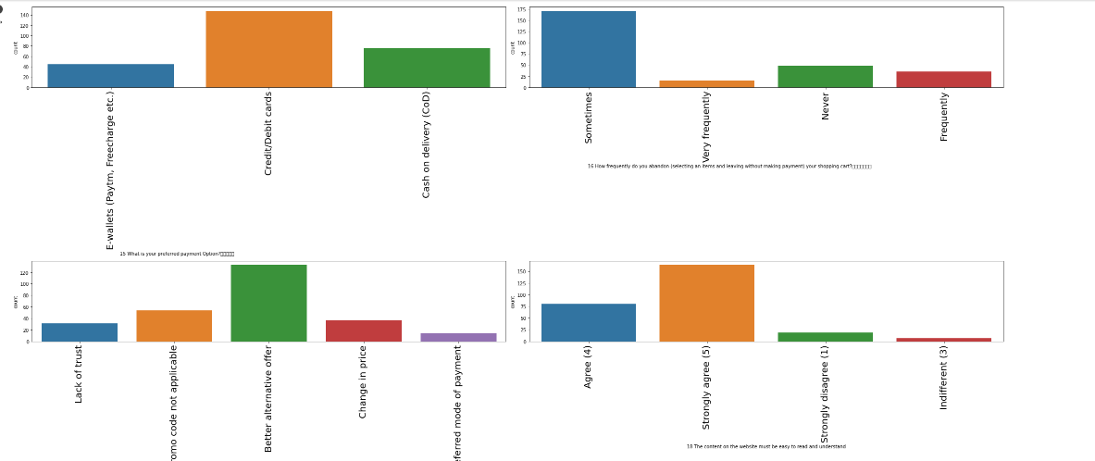
payment Option mostly people used for payments were credit/debit cards then 2nd preference of people was cash on delivery few used E-wallets.
If we count frequency of selecting an items and leaving without making payment in shopping cart it can be said the highest count was that of ‘sometimes’ and the least count was that of ‘very frequently’.
If reason is taken into count for above problem then i can say ‘better alternate offer, has the highest count while ‘preferred payment option’ problem had the least count.
Going by ‘The content on the website must be easy to read and understand’ people have voted more for “strongly agree” and “agree” . Strongly disagree was voted the least.

Slide 10
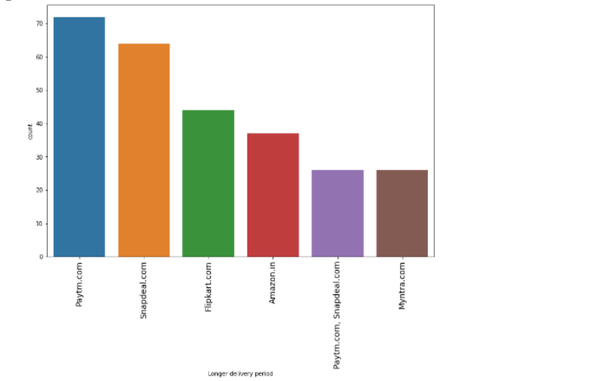
Store with the longest delivery period
Above graph indicates that paytm took very long time to deliver items next was snapdeal then flipkart and then amazon.

Slide 11
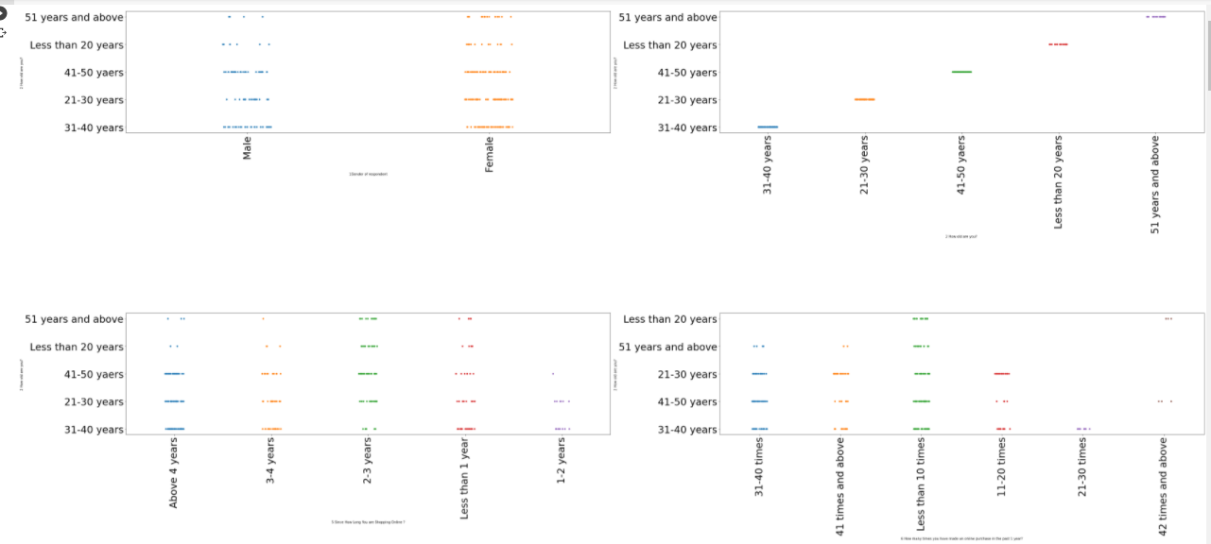
Comparison of age vs. other features according to preference.
From age vs gender, i can say for every age from young to old, females were more as compare to men.
From age vs Since How Long You are Shopping Online, i can say the people who are doing shopping above 4 are mostly in age between 31-50. and the people who are in 3-4 years range are aged 21-30 and same with 2-3 years are mostly in the age of 41-50 and the people who falls in less then 1 year category are 31-40 years of age.
From age vs How many times you have made an online purchase in the past 1 year, i can say mostly people who have ordered 31-40 times in a year have age 41-50 and with 41 time and more have age of 21-30 and less then 10 time are in 21-50age and 11-12 time are in age between 21-30 so i can say mostly 21-30 years of people are shopping more.
From age vs How do you access the internet while shopping on-line, i can say there are some people who use dial up who have a age of 31-40 and from wifi use i can say all of the people use wifi but 21-40 age of people use it more From mobile internet i can say mostly 21-50 age of people use it more as compare to others

Slide 12
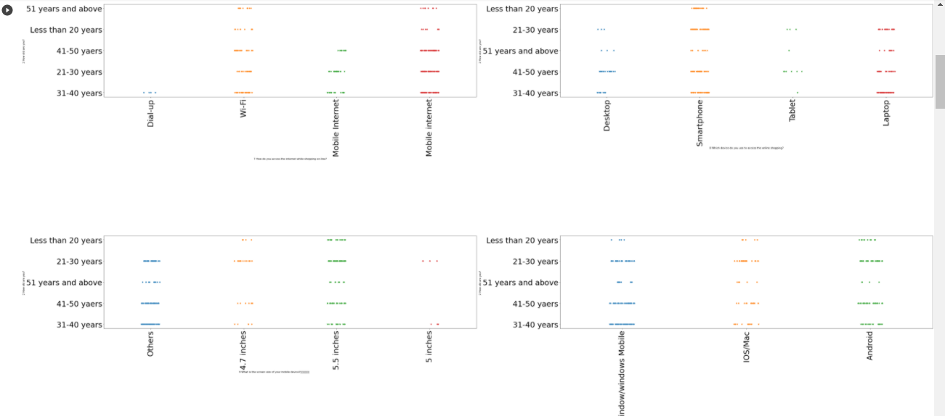
From age vs Which device do you use to access the online shopping, i can say people who have a age between 41-50 mostly use desktop and people who falls between age of 21-40 use mobile and there are some people who use tablet have an age of 41-50 and there are people who use laptop have an age of 21-50. so i can say mostly above 41 people use less mobile to order online and there are young people who only use mobile are aged between 21-40.
From age vs device size, i can say there are people who have big device size or less size as compare to 5.5 inch and there are people who use 4.7 inch mobile who have a age of 21-30 and mostly people use 5.5 inch mobile who have a age of 21-30and very less people use 5.5 inch mobile who have a age of above 51.
Age vs device type, i can say people who have an age of 31-50 use windows mobile more, and people use IOS who have a age of 21-30 means young people use it more and people use android who have a age of 21-40 more and less people use android who have a age of 41-50 and very less who have a age of 51+.
Age vs What browser do you run on your device to access the website, i can say people who have an age of 21-50 almost everyone use chrome and less people use it who have a age of below 20 and 51+ and people use safari more who have a age of 21-30 more and people with age 31-40 also use it but have a less count as compare to 21-30 there are only few people who use opera who have a age of 21-30 and very few people who use it have a age of 41-50 and few people use Firefox who have a age of 21-30 and 31-40 very few.

Slide 13
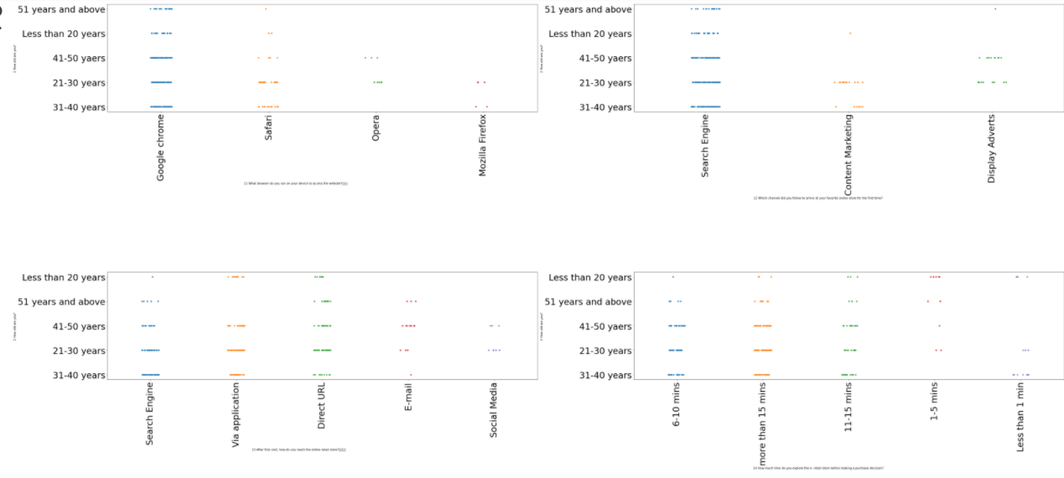
From age vs Which channel did you follow to arrive at your favorite online store for the first time, i can say people of every age use search engine but less people use it who are aged below 20 or above 51 as compare to 21-50 age of people and people use content marketing as compared to other who have a age of 21-30 and people use display advertise who have a age of 41-50.
From age vs After first visit, how do you reach the online retail store, people who have a age of 31-40 reaches the store by search engine as compare to other and people who have a age of 21-50 reaches the store by application and people who have a age of 31-40 and below 21 have very less count as compare to other who Reacher the store by using direct url except upper two ages all age of people used direct url and people who have a age of 41-50 mostly they use email to reach store.
From age vs How much time do you explore the e- retail store before making a purchase decision, i can say people who have a age of 21-50 have explored the store between 6-10 times and same people who have a age of 21-50 have explored it more than 15 times and there are less people but there are some peoples who have a age of 51 above and have explored it more then 15 times and there are more people who have a age of 41-50 and explored the store between 11-15 times and there are some people who are aged below 20 have explore it 1-5 times and there are some people who have a age of 31-40 who have explore it less than 1 time.

Slide 14
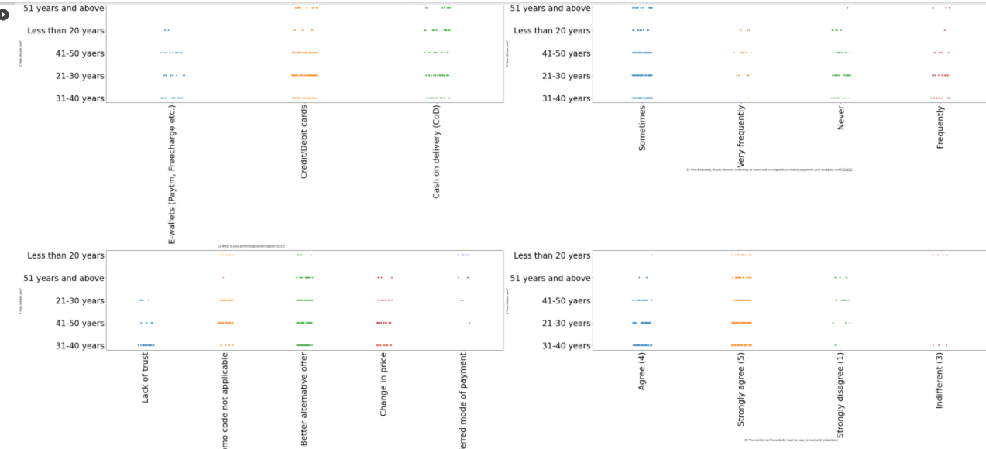
Age vs What is your preferred payment Option, i can say people who have a age of 31-50 used e-wallet more as compared to others and people who have age between 21-30 and 41-50 used credit card more and people who have age of 31-40 also use credit card but have a less count as compare to upper two ages and from cash on delivery i can say all the people use this option but 21-40 age have high count as compared to others.

Slide 15
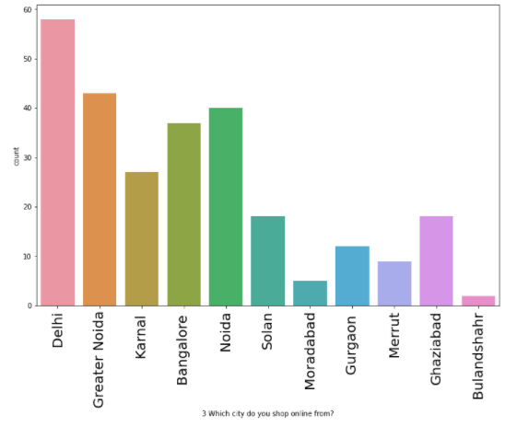
Which city people do shop online from?
From upper graph i can say Delhi has the highest count means people in Delhi orders the most.
After Delhi greater Noida has 2nd highest count and least count is Bulandsahar means people who live in Bulandsahar usually buy less online items.

Slide 16
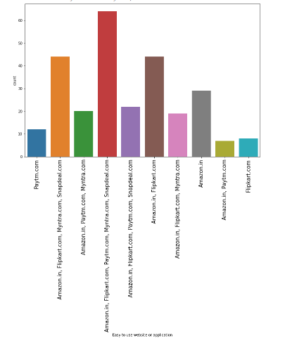
Easy to use website or application
From the graph i can say that only amazon have high count as compare to others and paytm has less count.

Slide 17
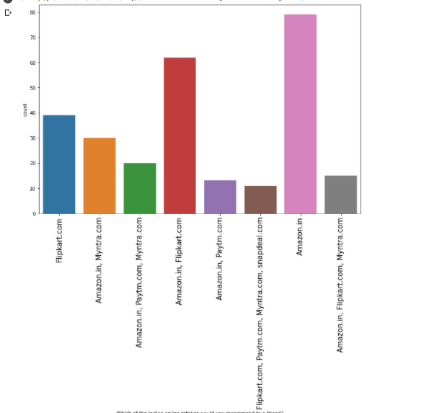
Mode of payment on most products.
From graph i can say snapdeal has the limited mode of payment and paytm has the least count.

Slide 18
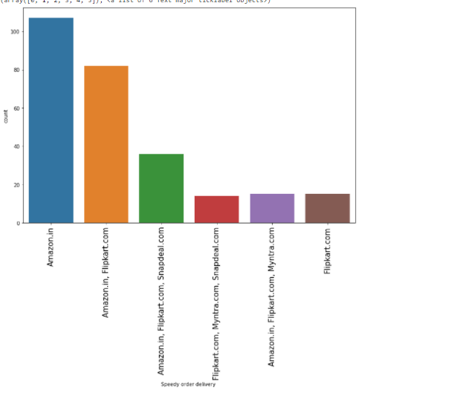
Recommendation by people
From graph i can say most of the people recommend amazon to there friend, after amazon people recommend flipkart

Slide 19
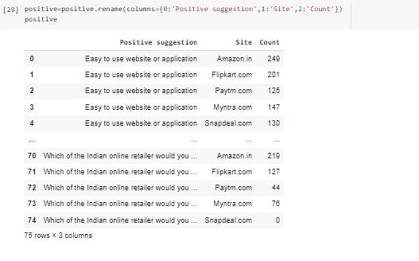
Positive review by all user for different sites
Amazon leads in this category as it has the highest count for positive reviews in recommendation to other user and ease for user. Followed by flipkart and then paytm.

Slide 20
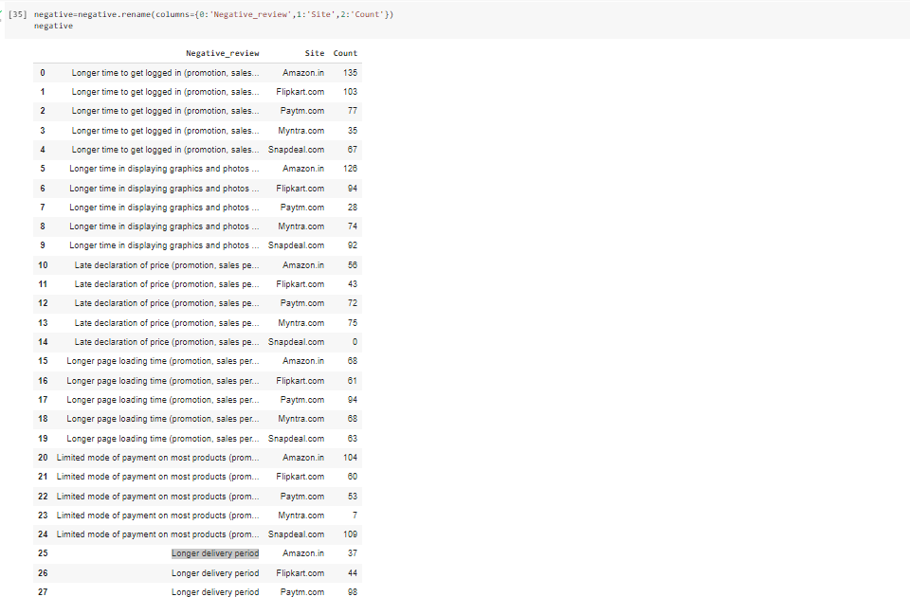
Negative review of peoples
From above data I can say that amazon has the highest negative reviews in terms of login time, display duration, price declaration, page loading time and mode of payment followed by flipkart and paytm.

Slide 21
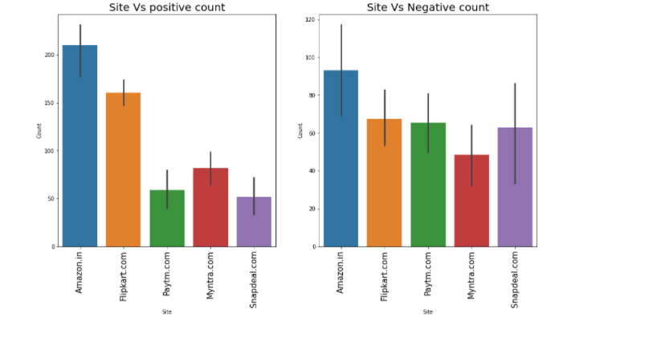
Positive Vs Negative review count
amazon has got high positive review as well as high negative review also but positive have high count as compare to other websites.
same is with flipkart and myntra.
But in case of paytm and snapdeal there is less positive review and high negative review.

Slide 22
Conclusion
1-Amazon
Positives
Easy to use website and application.
Visual appealing and better interface of web-page layout.
Good variety of product on offer.
Complete and relevant description information of product.
Fast loading website speed.
Reliability of the website or application is good.
Quick to complete purchase.
Availability of several payment options.
Speedy order delivery.
Privacy of customers’ information.
Security of customer financial information..
Presence of online assistance through multiple choice.
Website is as efficient as before.
.
Improvements.
Reduce longer time to login.
Reduce Longer time in displaying graphics and Photos.
Late declaration of price should be improved.
Reduce Longer page loading time.
More payment options must be added.
They should Reduce Longer delivery period

Slide 23
2-FLIPKART
Positive
Easy to use website or application.
Visual appealing web-page layout and interface.
Numerous product on offer.
Complete, relevant description of product.
Fast loading website speed.
Reliability of the website or application is good.
speedy purchase complete setup.
Availability of several payment options.
Speedy order delivery.
Privacy of customers’ information.
Security of customer financial information.
Perceived Trustworthiness.
Presence of online assistance through multi-choice.
Website is as efficient as before.
Improvement to be done in flipkart
Logging-in time is longer.
Displaying graphics and photos takes time.
Price declaration should be done early.
Longer page loading time.
Limited mode of payment on most products.
Longer delivery period.
Change in website/Application design.
Frequent disruption when moving from one page to another.

Slide 24
3-Paytm.com
Positives
Easy to use website or application.
Visual appealing web-page layout.
Wild variety of product on offer.
Complete, relevant description information of product.
Fast loading website speed of website.
Reliability of the website or application.
Privacy of customers’ information.
Security of customer financial information.
Perceived Trustworthiness.
Presence of online assistance through multi-choice.
Improvements
Longer time to get logged in.
Longer time in displaying graphics and photos.
Late declaration of price.
Longer page loading time.
Limited mode of payment on most products.
Longer delivery period.
Change in website/Application design.
Frequent disruption when moving from one page to another.

Slide 25
4-Myntra
Positive
Easy to use website or application.
Visual appealing web-page layout.
Complete, relevant description information of product.
Fast loading of website.
Reliability of the website or application.
Quickness to complete purchase.
Availability of several payment options.
Speedy order delivery.
Privacy of customers’ information.
Security of customer financial information.
Perceived Trustworthiness.
Presence of online assistance through multi-choice.
Website is as efficient as before.
Improvements
Longer time to get logged in.
Longer time in displaying graphics and photos.
Late declaration of price.
Longer page loading time.
Limited mode of payment on most products.
Longer delivery period.
Change in website/Application design.
Frequent disruption when moving from one page.

Slide 26
5-Snapdeal
Positive
Easy to use website or application.
Visual appealing web-page layout.
Wild variety of product on offer.
Complete, relevant description information of product.
Fast loading website speed of website.
Reliability of the website or application.
Availability of several payment options.
Speedy order delivery.
Privacy of customers’ information.
Security of customer financial information.
Website is as efficient as before.
Improvements
Longer time to get logged in.
Longer time in displaying graphics and photos.
Late declaration of price.
Longer page loading time.
Limited mode of payment on most products.
Longer delivery period.
Change in website/Application design.
Frequent disruption when moving from one page.
NOTE- All people have some common positives and have some common areas to improve.

Slide 27
THANKYOU

